Slide 1
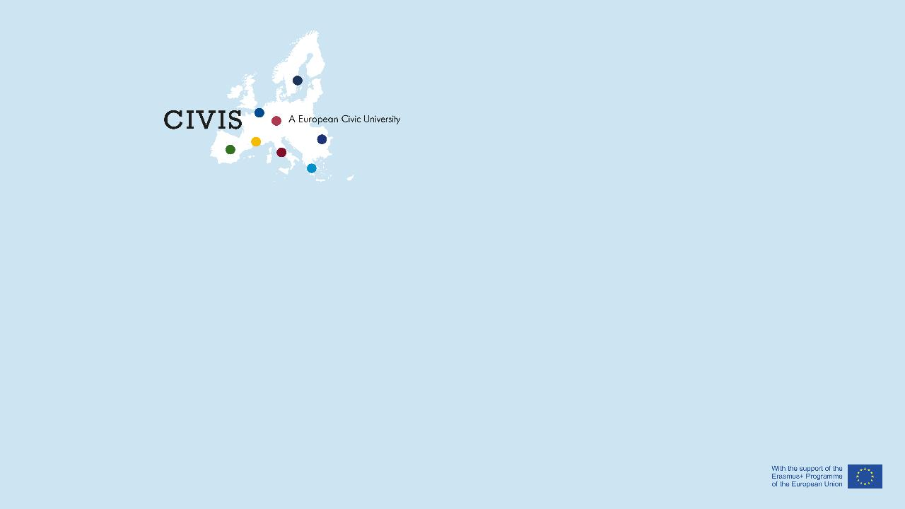
PhD student mobility

Slide 2
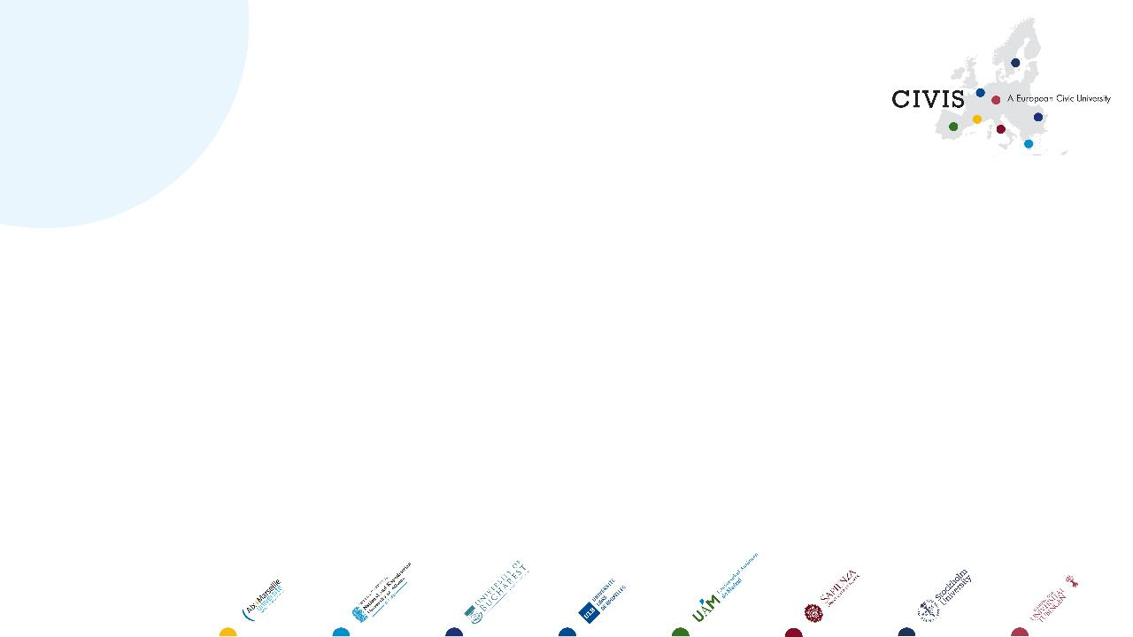
Contact details
University: Aix Marseille
Departement/faculty/research unit: Institute of Fusion Science and Instrumentation in Nuclear Environements (ISFIN)
Name/Surname: Gilles CARTRY
Function: deputy director for education
Email address/Phone number: isfin-direction@univ-amu.fr
Webpage: https://www.univ-amu.fr/en/isfin
Created by Aix-Marseille University, the ISFIN (Institute for Fusion and Instrumentation Sciences in Nuclear Environments) fosters training and research in fusion sciences, nuclear instrumentation, and the mechanical characterization of materials and structures for fission and fusion, with an interdisciplinary approach, including societal aspects

Slide 3

My/our project
The graduate school (GS) in Fusion Science and Instrumentation in Nuclear Environments (ISFIN) at AMU wants to encourage the international mobility of its PhD students, through a call for mobility. The draft of the call is attached to this document. Basically, the student is free to move in any laboratory to develop a new collaboration, learn a new technique, increase its disciplinary skills, get a chance to obtain the European PhD label... This mobility can be out of the main stream of its PhD topic, in agreement with the PhD advisor(s).
The ISFIN GS wants to encourage mobility within CIVIS. For that purpose we are looking for possible host laboratories within CIVIS, which would potentially accept to receive PhD students for a period between ~6 weeks and 3 months. The scientific program of the visit would have to be co-defined by the candidate and the host laboratory prior to the project submission. If accepted, the mobility costs of the PhD students would be integrally funded by ISFIN.

Slide 4
My/our project
Students of our graduate school have either:
a formation in fundamental physics with a specialization in Fusion science, or
a formation in Instrumentation, Metrology, Measurement with a specialization in nuclear instrumentation, or
a formation in mathematics/mechanics with a specialization in modelling, or
an engineering formation in material or thermal science, or
a formation in sociology or law
Their PhD subjects deal with:
Edge plasma physics and plasma wall interactions
Physics of containment of magnetized plasmas
Nuclear instrumentation and detection: sensors/detectors, ruggedized electronics
Materials and Structures: Characterization and Modeling
Thermal diagnostics and measurement of thermophysical properties
Human and Social Sciences, laws, in relation with nuclear topics

Slide 5
Link to CIVIS
My/our initiative relates to the following CIVIS global challenge:
☒ Climate, Energy, Environment
Health
Society, Culture, Heritage
Digital & Technological Transformations
Cities, Territories, Mobility
We are looking for potential host laboratories doing research in one of the field in relation with the formation of our students (see previous slide)

Slide 6
Partnership
I/we would like to include the following universities in our initiative
Aix Marseille University
☒ University of Bucharest
☒ National and Kapodistrian University of Athens
☒ SAPIENZA Università di Roma
☒ Eberhard Karls Universität Tübingen
☒ Stockholm University
☒ Université Libre de Bruxelles
☒ Universidad Autónoma de Madrid
And any institute having a framework agreement with CIVIS universities

